Slide 1




NEXT GEN EMPLOYABILITY PROGRAM
Creating a future-ready workforce
Team Members
College Name
Student Name : Arun Mariappan ME
Student ID :au951221104006
JP College Of Engineering

Slide 2

CAPSTONE PROJECT SHOWCASE
Project Title
Voting Web Application using Django Framework
Abstract | Problem Statement | Project Overview | Proposed Solution | Technology Used | Modelling & Results | Conclusion

Slide 3
Abstract
Our voting web application, built on the Django framework, revolutionizes democratic engagement by offering a user-friendly platform for citizens to participate in elections securely. Leveraging Django's robust architecture ensures scalability and data integrity, while intuitive design enhances user experience. Real-time updates and transparent result displays foster trust in the electoral process, promoting civic participation and accountability. Empowering citizens with accessible and efficient voting tools, our platform signifies a significant step towards enhancing democratic practices in the digital era.
Source :

Slide 4
Problem Statement
Current voting systems lack accessibility and user-friendliness, deterring participation.
Concerns regarding the integrity and security of online voting platforms Limited Accessibility: Existing voting systems often lack inclusivity, hindering participation among diverse demographics and marginalized communities.
Security Concerns: Online voting platforms face persistent threats of cyberattacks and data breaches, raising doubts about the integrity and confidentiality of the electoral process.
Lack of Transparency: Traditional voting methods often lack real-time result tracking and transparent reporting mechanisms, leading to skepticism and distrust in electoral outcomes.
Source :

Slide 5
Project Overview
The project aims to develop a secure and user-friendly platform for conducting online Project Name: "Votex: Empowering Digital Democracy"
Objective: Develop a user-friendly web application using Django framework to facilitate secure and transparent voting processes.
Features: Real-time result tracking, robust security measures, intuitive user interface, and scalability for widespread adoption.
Impact: Enhancing democratic participation, fostering trust in electoral procedures, and advancing civic engagement in the digital age.voting and surveys, utilizing the Django framework.
Key features include user authentication, intuitive interfaces for administrators and participants, real-time result updates, and data visualization.
Source :

Slide 6
Proposed Solution
.
Development of a user-centric voting web application leveraging Django framework to ensure accessibility and ease of use for diverse demographics.
Implementation of advanced encryption and secure authentication protocols to safeguard voter data and protect against cyber threats, ensuring the integrity and confidentiality of the electoral process.
Integration of real-time result tracking and transparent reporting mechanisms to provide voters with immediate access to election outcomes, enhancing trust and accountability.
Emphasis on user education and support to address technological barriers and promote widespread adoption of the voting platform, fostering inclusivity and equitable participation
Source :

Slide 7
Advantages
Increased Participation: Accessibility from any internet-connected device facilitates broader engagement in the voting process.
Efficient Development: Leveraging Django framework expedites development cycles, optimizing resource utilization. Increased Accessibility: The web-based platform allows voters to participate in elections from anywhere with internet access, promoting inclusivity and democratic engagement.
Enhanced Efficiency: Leveraging the Django framework streamlines development processes, enabling rapid iteration and deployment of features, saving time and resources.
Source :

Slide 8
Disadvantages
Digital Exclusion: Dependent on internet access, the platform may exclude individuals without reliable connectivity or technological literacy, perpetuating disparities in democratic participation.
Vulnerabilities to Cyber Attacks: Despite security measures, online platforms remain susceptible to hacking or data breaches, compromising the integrity and confidentiality of voter information.
Potential for Technical Glitches: Complexities in web application development may lead to bugs or system failures, disrupting voting processes and eroding user trust
Source :

Slide 9
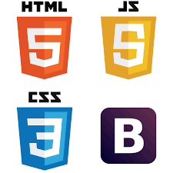
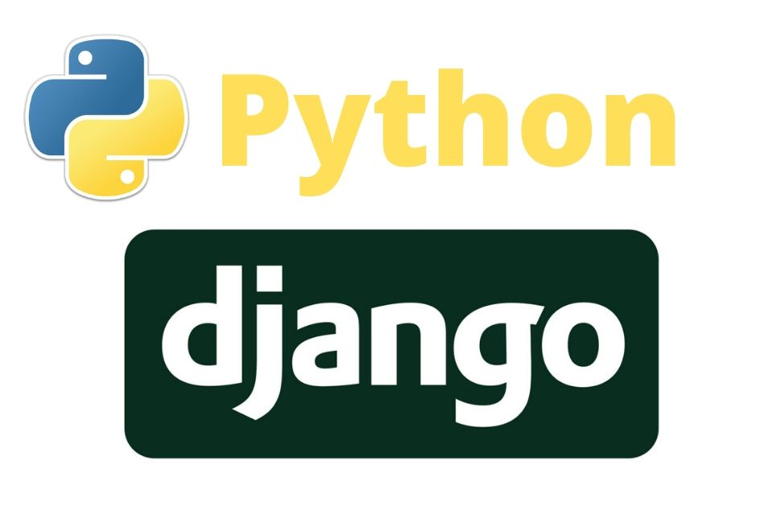

Technology Used
Frontend
Backend
Source :

Slide 10
Modelling & Results
Data Modeling: Utilize Django's ORM to design efficient database models, facilitating storage and retrieval of user, poll, and voting data.
Algorithm Implementation: Develop algorithms for processing votes and calculating results, ensuring accuracy and responsiveness in displaying electoral outcomes.
Testing and Validation: Conduct rigorous testing to validate model functionality and algorithm accuracy, addressing any discrepancies or errors to maintain data integrity.
Source :

Slide 11
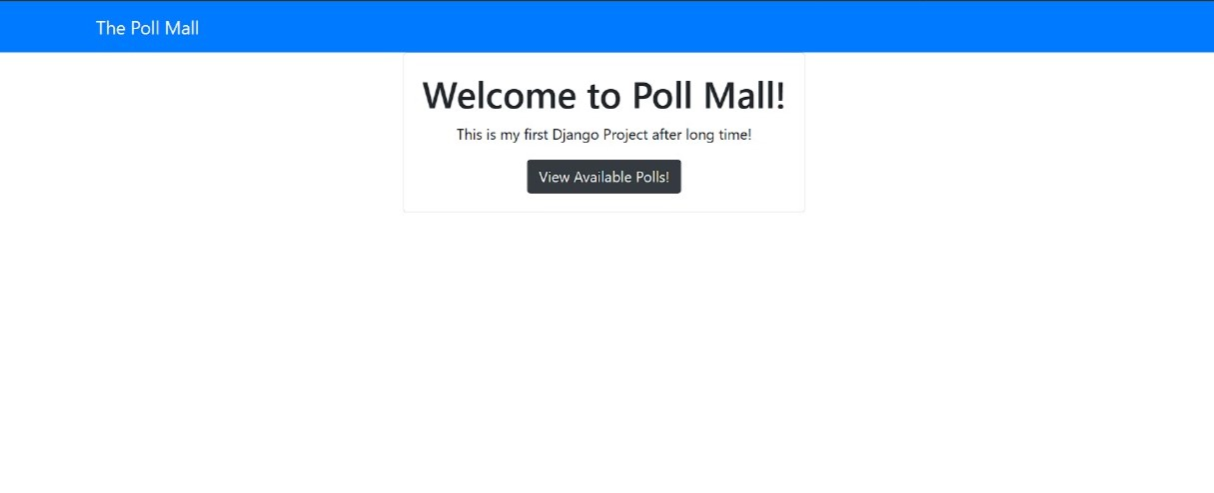
Homepage

Slide 12
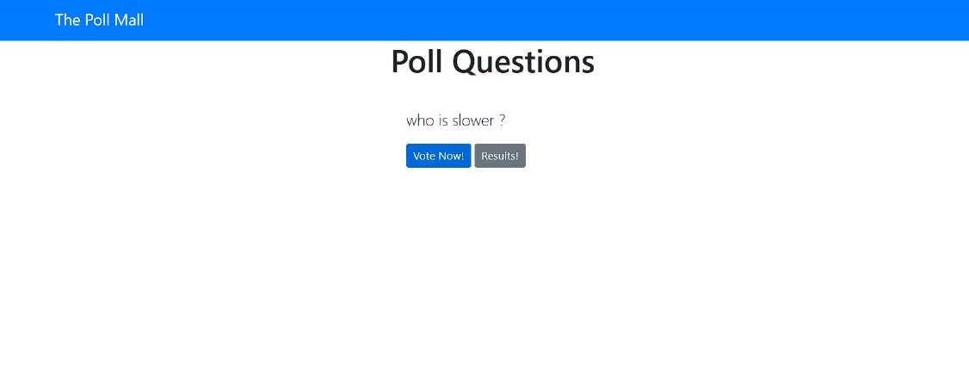
Polling questions page

Slide 13
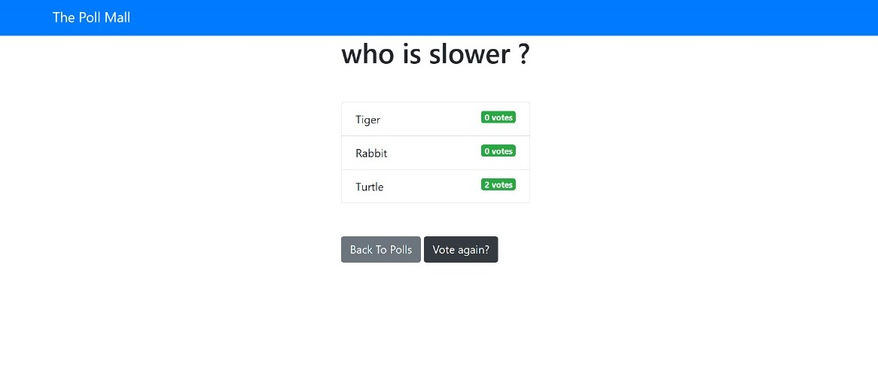
Voting page

Slide 14
Future Enhancements:
Blockchain Integration: Explore incorporating blockchain technology to enhance security and transparency in the voting process, ensuring immutable and verifiable records of votes.
AI-Driven Personalization: Implement AI algorithms to customize user experiences, providing personalized recommendations and notifications tailored to individual voting preferences.
Mobile Application Development: Expand accessibility by developing dedicated mobile applications, enabling seamless voting experiences on smartphones and tablets.
Gamification Elements: Introduce gamification features to incentivize participation and foster community engagement, encouraging voter turnout and involvement in the electoral process

Slide 15
Conclusion
In conclusion, our voting web application built on the Django framework represents a significant step forward in modernizing democratic processes. By prioritizing accessibility, security, and transparency, we aim to empower citizens to actively participate in shaping their communities and societies. While challenges such as digital exclusion and cybersecurity threats persist, our platform's robust features and ongoing commitment to innovation promise to address these concerns effectively. Through collaboration with regulatory authorities and continuous refinement based on user feedback, we are confident in the platform's ability to foster trust, accountability, and inclusivity in democratic practices. Together, we can pave the way for a more equitable and participatory future in governance, driven by technology and guided by democratic ideals
Source :

Slide 16
Thank You!
Notes:
Thank You !!

